Slide 1
Examination of HDP/BDP Group Speeches: An LDA Model
İsa Ali Demir

Slide 2
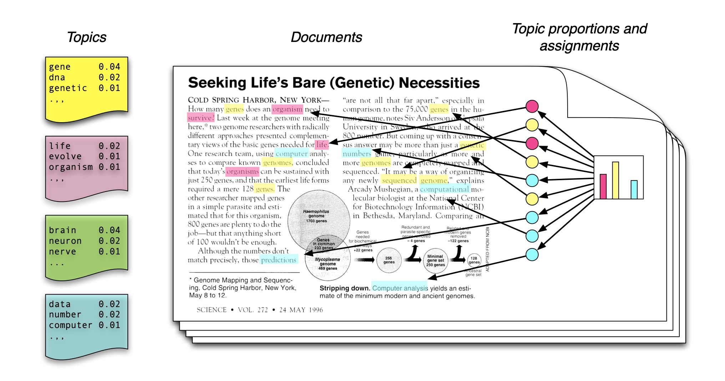
What is LDA?
Amplified reading
Topic modeling
Unsupervised ML Model
Fully Automated Clustering
Classifying to Unknown Categories
Mixed-Membership Model
Documents exhibit multiple topics
Topics are distribution over words

Slide 3
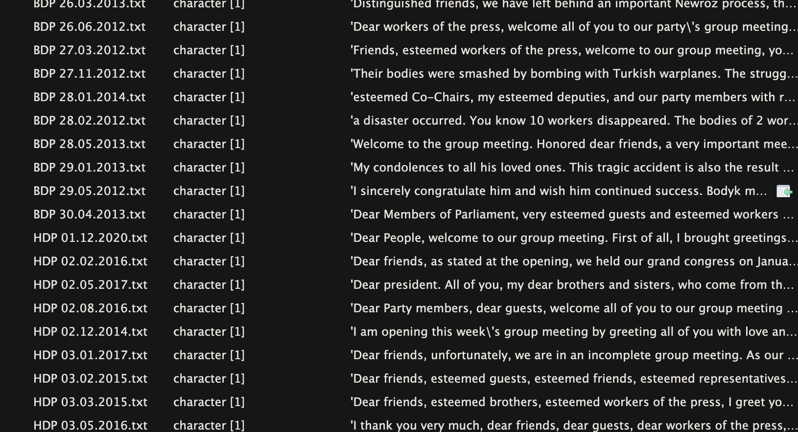
Data
HDP/BDP Group Speeches
Speech to word
123 document
Google AI Translation
From Turkish to English for pre-processing

Slide 4
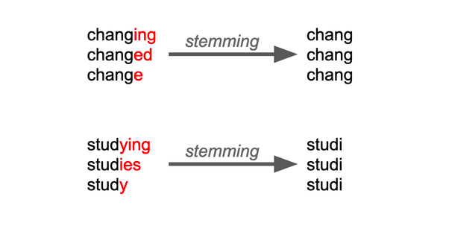
Pre-processing
UTF-8 encoding
Lower case
Stopwords (but, the, and etc...)
Stemming
Trimming (0.01-0.99 quantile)

Slide 5
Important: Number of Topics
K is the number of topics
Model does not tell you how many topics are in the corpus
Instead, you have to tell the number of topics to the model
There is no “right” number
Validation, validation, validation!

Slide 6
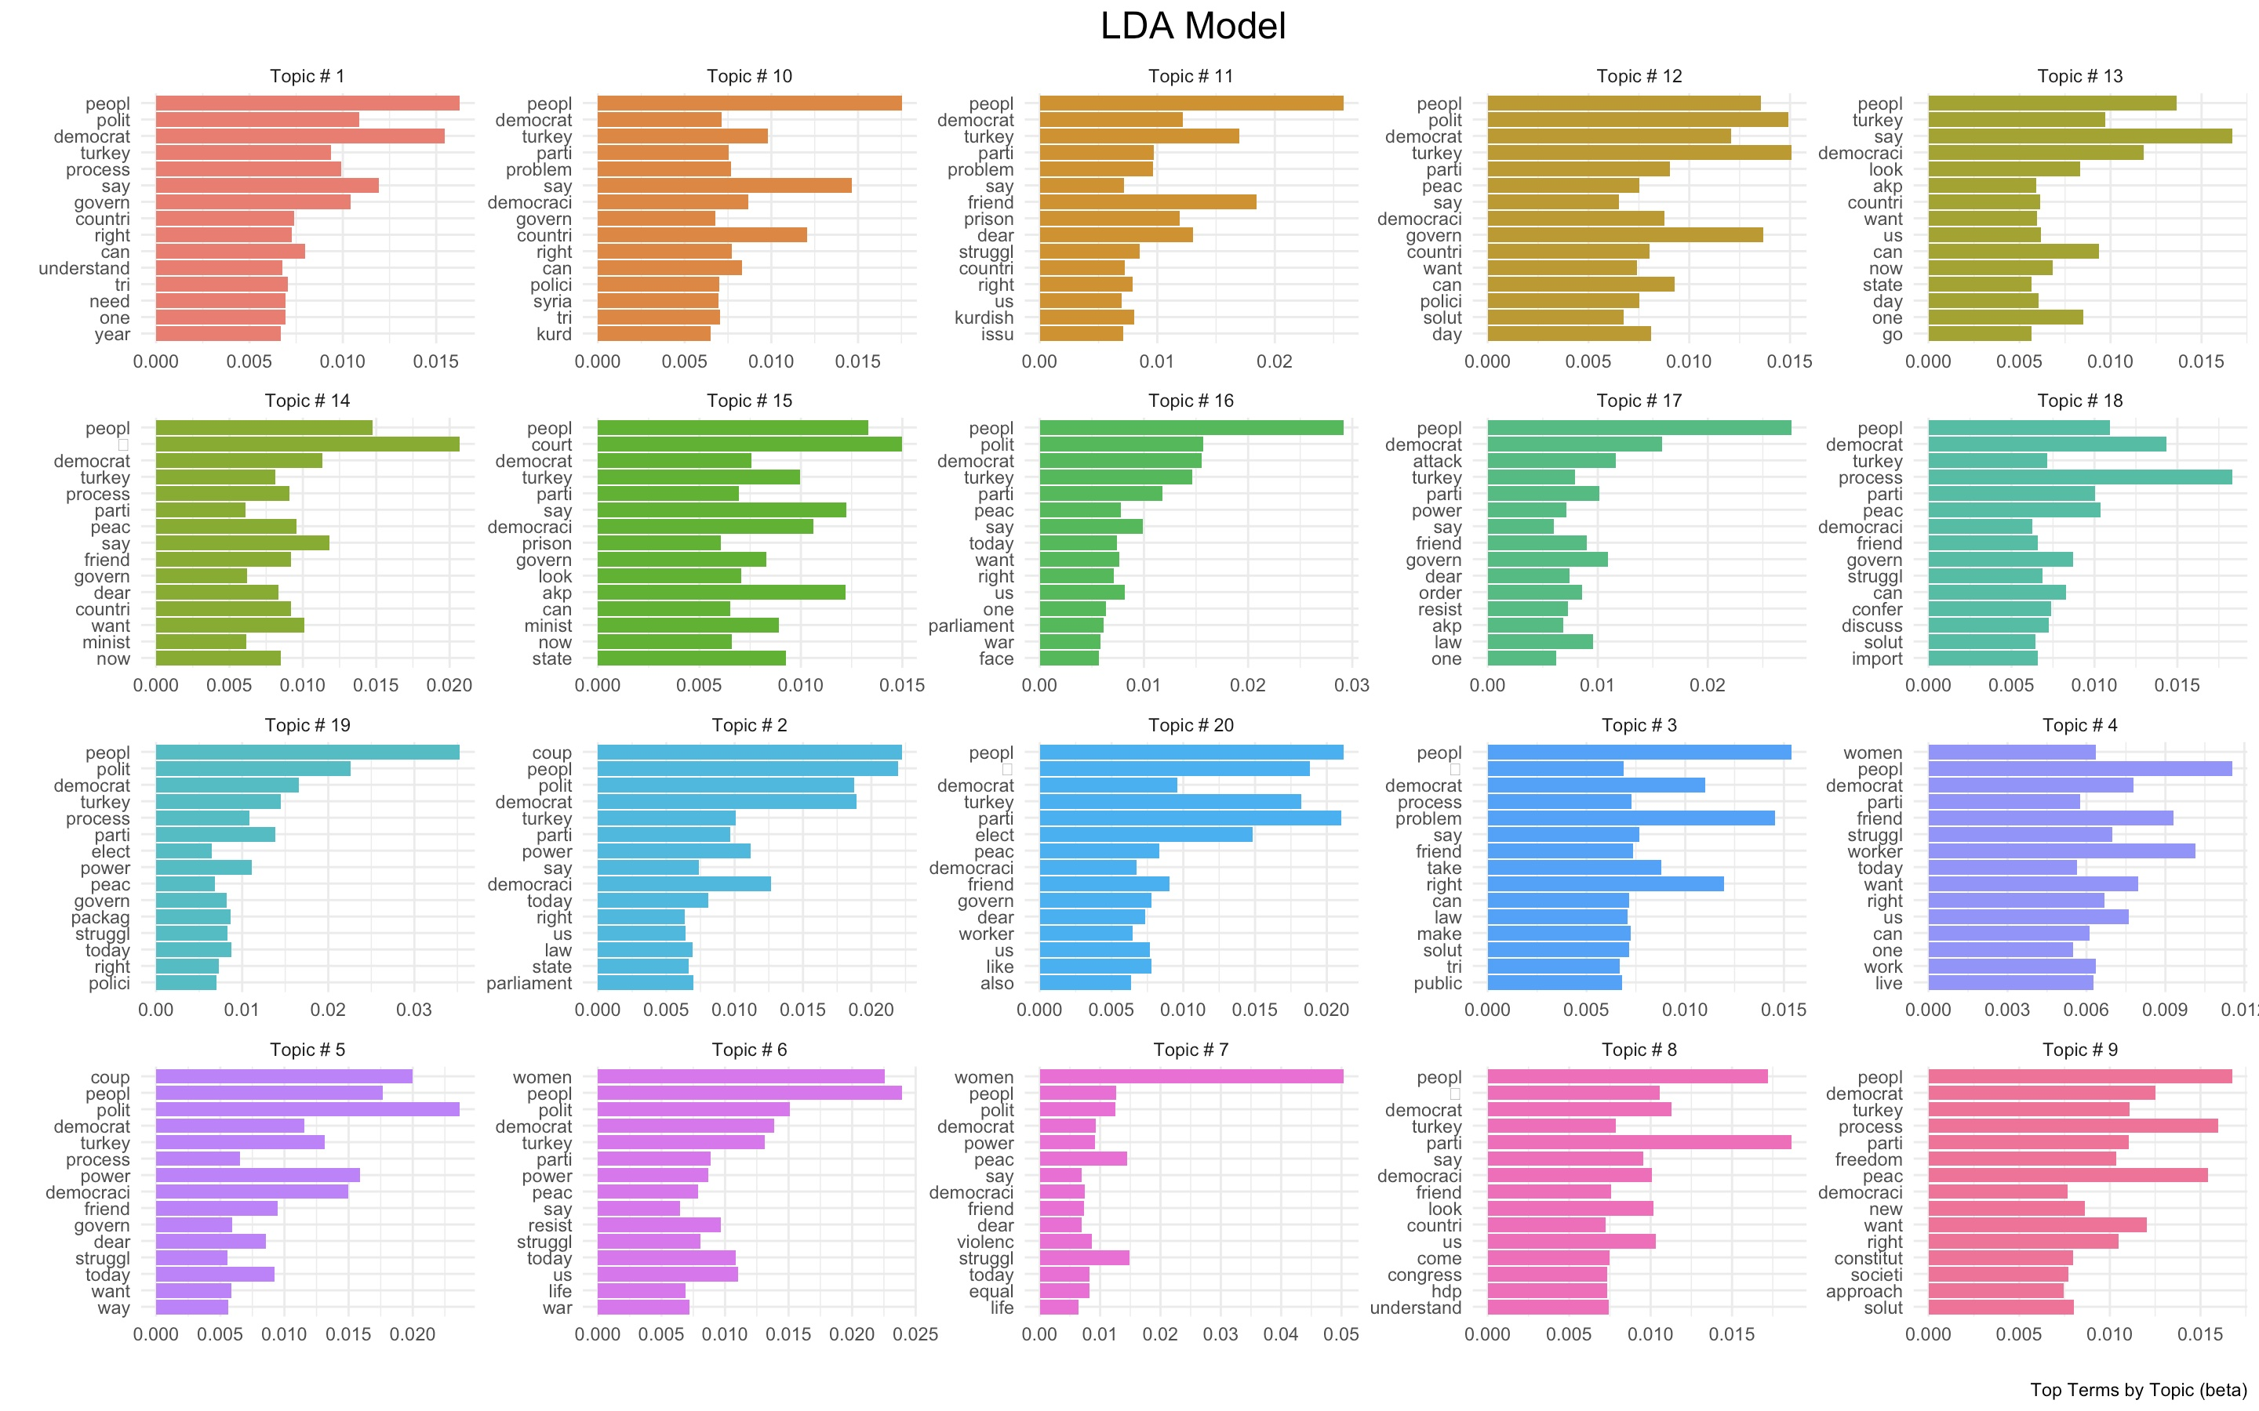
Model (K=20)

Slide 7
Thanks!

